Slide 1
Report for Community Council
24th January 2022 – 18th February 2022

Slide 2
Numbers:
We have worked with 277 young people
This equated to 300 learning hours
This happened at 32 different activities

Slide 3
Well Wishes Project
Well Wishes is a mindful craft activity based on the tradition of healing ‘Clootie Wells’. (This has is quite a topical subject on social media after someone clearing the clootie-well at Munlochy)
They will go on display in Inverness Museum and Art Gallery in April as part of their Health, Wealth and Happiness exhibition,
Then will be composted, reflecting the tying of cloths at healing wells – decay of the fabric represents fulfilment of the wish.
Then young people learnt how to create a fabric braid.
Each person was given 3 leaves-
One for display in the Inverness Museum and Art Gallery
One for display in the Youth Work Classroom in Fortrose Academy
One for the young person to take home

Slide 4
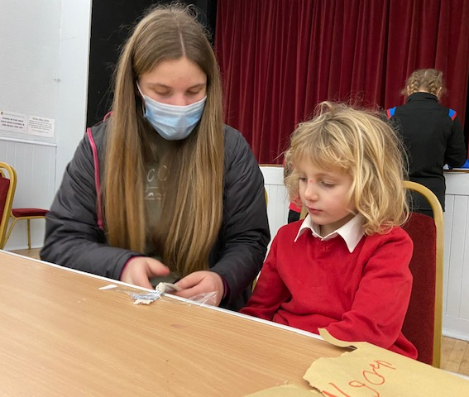
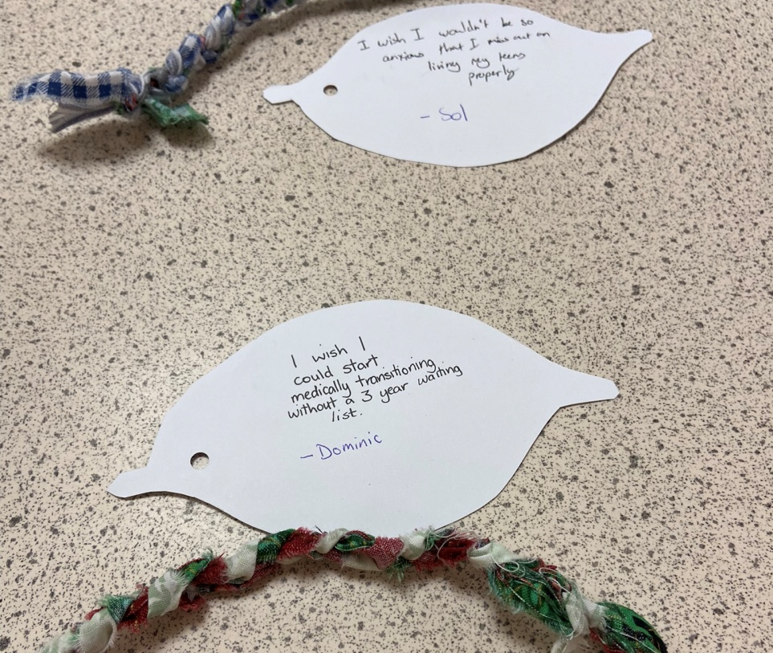
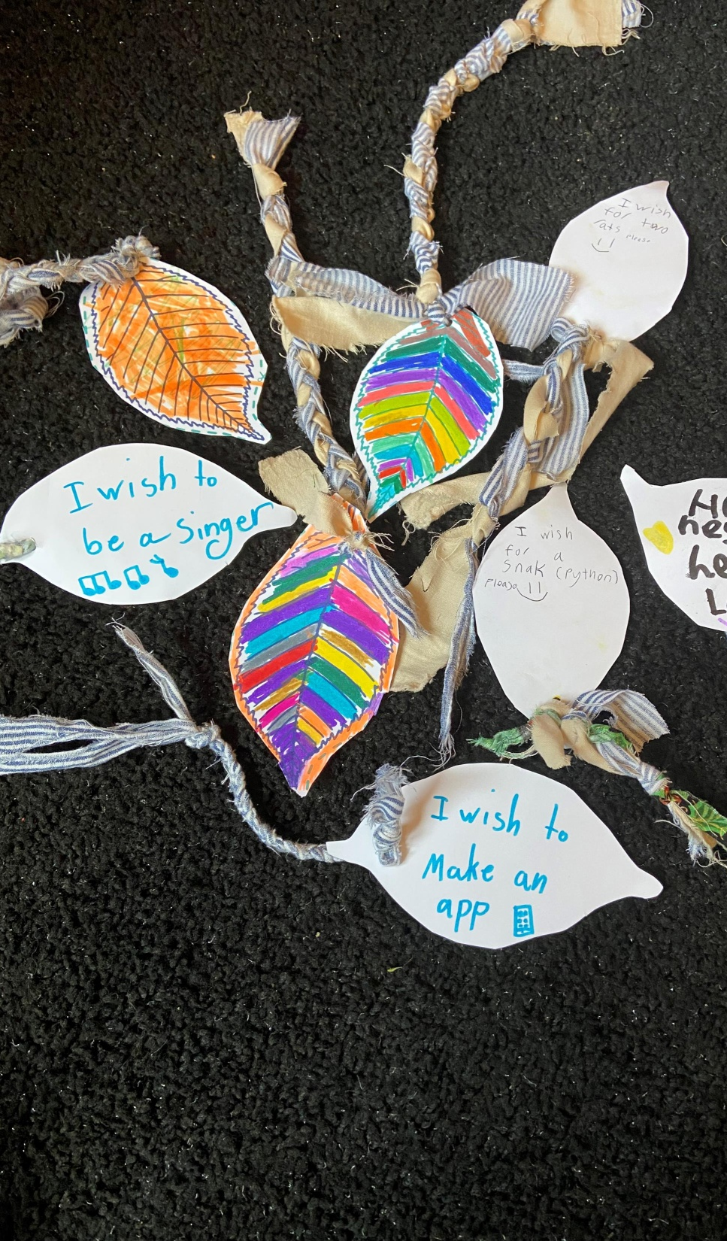
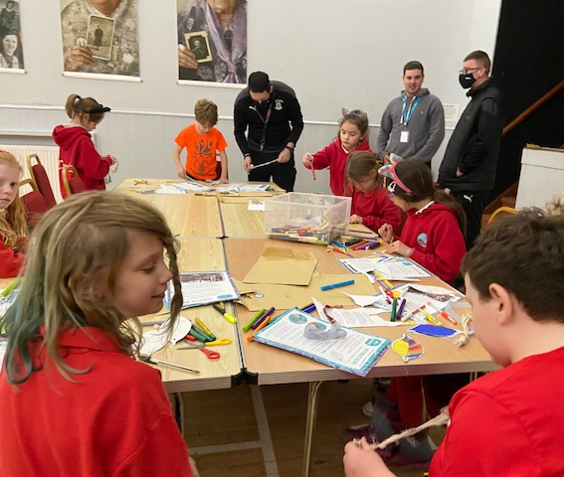
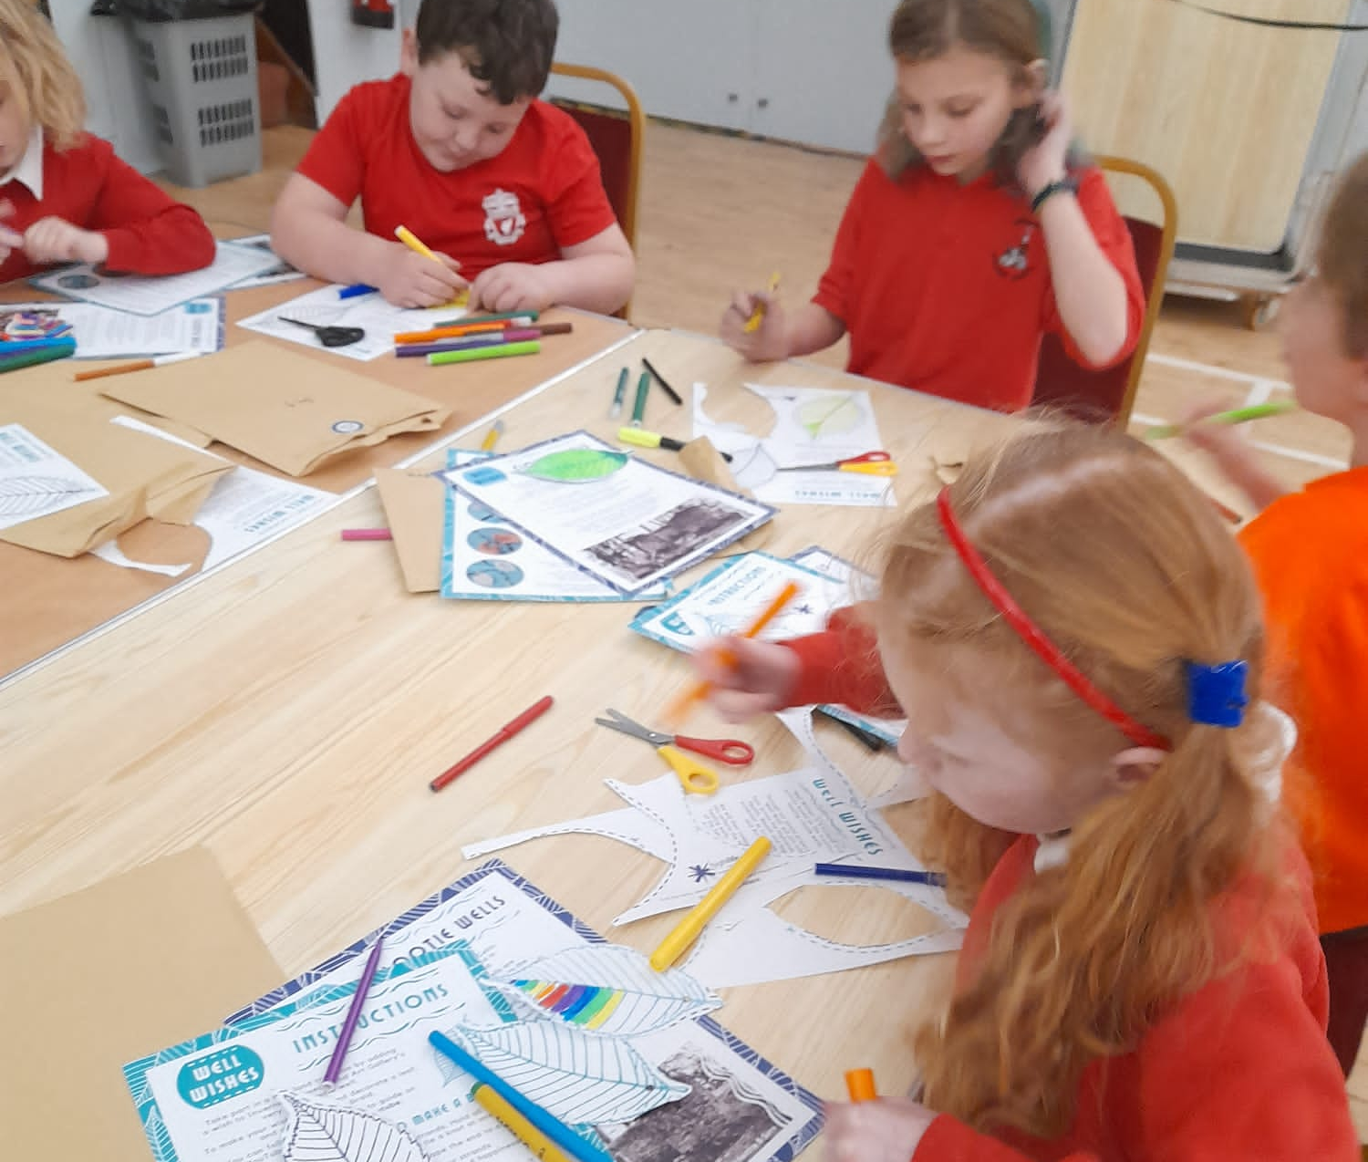

Slide 5
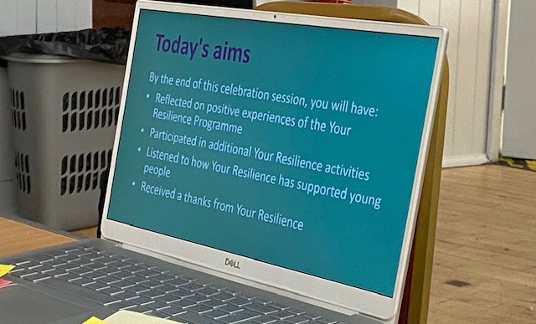
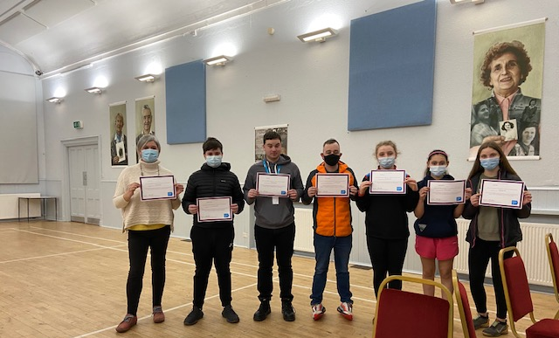
Resilience in Your Community Final Session / Evaluation
At this session young people were asked to give their feedback on the project.
Young People were given post it notes to write down their answers anonymously

Slide 6
Resilience Evaluation Comment from Young People
What I didn’t like and why:
I didn’t like the managing studies because it was not helpful to me
I don’t mind writing stuff, but I don’t like writing stuff
All the PowerPoint information because I prefer doing stuff not listening to stuff
I didn’t like the stuff on managing studies because I do not have exams yet.
I liked all of it
I did not like the exam stuff as I am not doing exams right now, but I can see how it might help me in the future.
Suggestions to improve or remove:
I think you could take out the stuff about managing studies and improve the session on making decisions
I think there could be more on managing social pressures and friendships as they are beneficial life skills
As it was a small group, I felt pressured to speak, which I didn’t like. I think you could ask if people would like to comment
It could be improved by making the sessions shorter as they were a bit long for me
More activities and less talking
What I liked and why:
Doing the activities and answering questions, I felt involved
I liked the social pressures and friendships because they were the ones where I gathered most useful information
I liked learning about what resilience is and I also liked the making decisions about our futures.
I liked the toothpaste exercise and the way the course was run
I liked the toothpaste exercise as it was a good example to show what is out you can’t take back

Slide 7
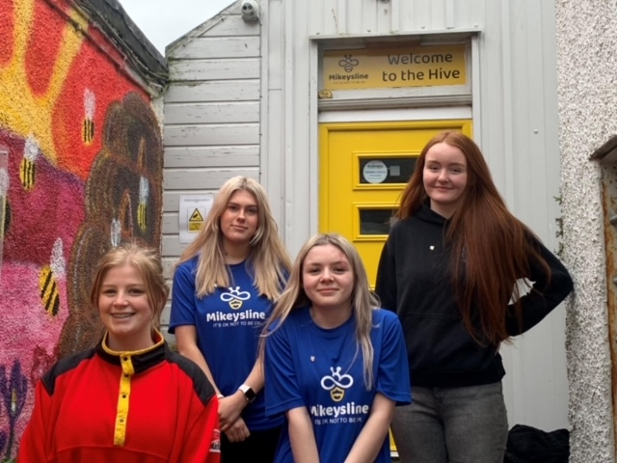
Mikey’s Line Ambassadors
4 of our young Saltire volunteers have become Mikey’s Line ambassadors
The girls have been organising virtual assemblies, presentation and are working on lots of plans for going forward to help raise awareness of mental health.

Slide 8
Partnership Work with CFINE
C Fine is a charity based in Aberdeen who donated pallets of food to community groups.
Wanda had a meeting with Mike Sutherland from CFINE to progress our partnership in this project.
After the meeting with Mike Cromarty Youth Café received our first ½ pallet of food. The Pallet comes from Aberdeen, Alan P very kindly accepts the pallet on our behalf and help to decant the items into the hall.
All the items on the Pallet would be going to landfill
“Tackling Food Poverty together in partnership with CYC & CFINE”

Slide 9
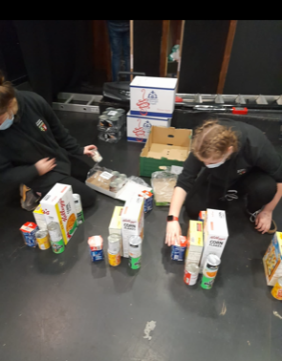
Isolation Packs
With some of the items from the pallet of food Cromarty Youth Café created health and well being bags for all members of the youth café, as there was no youth café one week due to the increase of COVID numbers locally some classes in the primary school were asked to remain at home,
Each young person received:
A colouring book set, selection of fruit , chocolate crunchy crispys , double chocolate chip banana muffins, Home made Pizzas
Breakfast packs for our seniors with homemade marmalade and a range of goodies

Slide 10
Cromarty Youth Cafes Intergenerational Journey
Over the last month we have been working with Black Isle Cares & Shoremills Care Home to enable older people to be come digitally connected, a selection of older people were loaned tablets from Black Isle Cares.
We are going to be part of one the residents 100th birthday celebrations, two young people from Cromarty Youth Cafe are creating a card for this lady, and we are going to get 100 signatures on the card.
One of the other people who was given a tablet was able to have Microsoft teams meeting with a Postgraduate Student & Trainee Clinical Psychologist Researcher - Shi Ting Lau

Slide 11
Cromarty Youth Cafes Intergenerational Journey cont…..
Young people from Cromarty had a meeting with Anne Macdonald from Highland senior Citizens network organised by Wanda to discuss an idea Wanda has a about a buddy bench in the park – this bench would be a place were people can sit and reflect. Another project would be a QR Code project. QR codes would be placed around the town and each code would have a memory of Cromarty, such as the Cromarty Song,
Older people were also given a fresh nutritional meal, these meals were donated from the Highland Homeless Trust
Myself & Wanda attended the Generations Working Together AGM to find out about other Intergenerational projects and to showcase the work we are doing.

Slide 12
Last Aid Training with Highland Hospice
Excellent course with The Trucanta Project and The Highland Hospice very proud of these young people and staff at Cromarty Youth Cafe for completing and passing the course they are all now Last Aiders the project aims to improve peoples experiences of death , dying , loss and care
- Good Life
- Good Death
- Good Grief
The initiative promotes more open and supportive attitudes and behaviours relating to death , dying and bereavement, we are all to aware we have an ageing population and our young people are keen to show they care , have compassion and want to take action to improve difficult situations and experiences for local people ❤️‍🩹

Slide 13
Last Aid Evaluation.
Orlagh MacIver
I really enjoyed all of it , it taught me a lot that I did not know, I like the fact that not only I will benefit but so will others . I feel that if you were delivering this course to other young people the part about talking about death to children should be possibly changed to talking to an adult about death young should be encourage to use the words, death , dead and dying
Imogen Macdonald
I found the course very interesting , I learnt a lot I did not know about, I enjoyed the interactive stuff fun and skills
Loreta Vitola
The course was really good I found a lot out we did not know , I enjoyed the hand cream massaging cause it would be good for relieving stress .
Kelsey Benjamin
I think it is good that kids should use the words death , dying and dead , and I liked all the food
Wanda Mackay
I have to say I thought it was very powerful using the words : I Love you , I forgive you & I am sorry

Slide 14
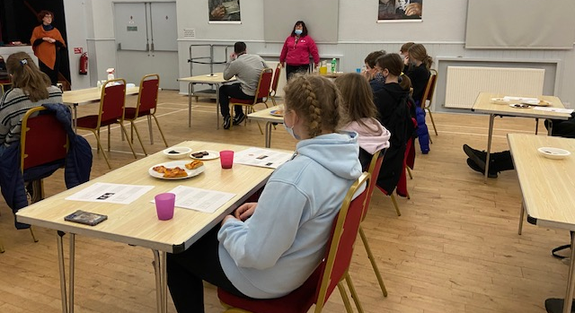
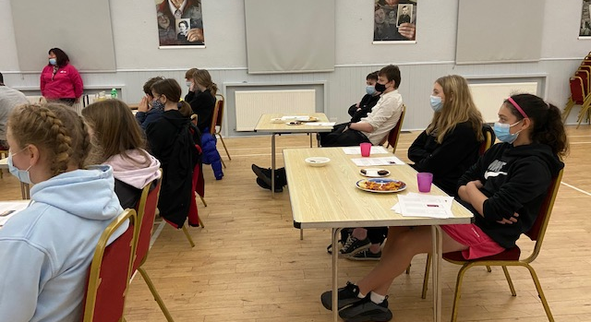
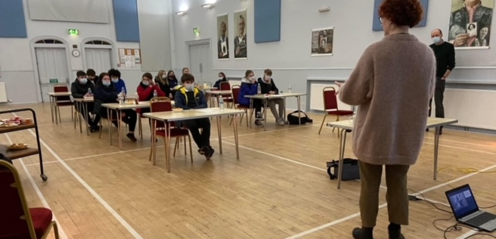
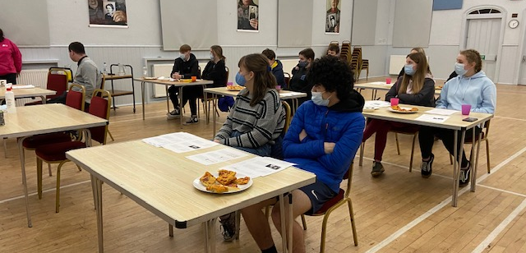

Slide 15
Multi Sports
Every Monday night, this is led by Young leaders
The young leaders are working toward Their Choose Lead Level 4 with High Life Highland
Young leaders plan , deliver and then review the session
The plan is always delivered around what young people want,
Each week young people are playing new games and are working on different skills, such as team work, throwing and catching, & communication skills

Slide 16
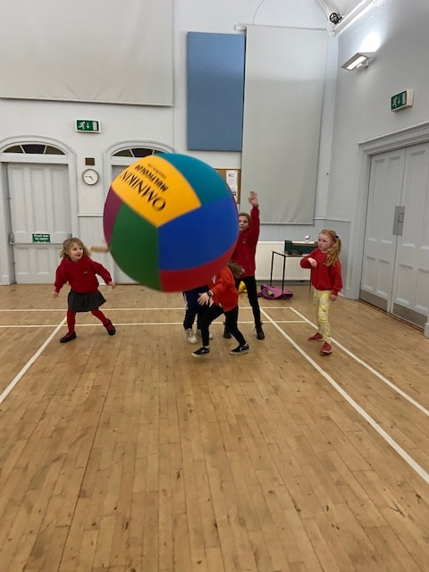
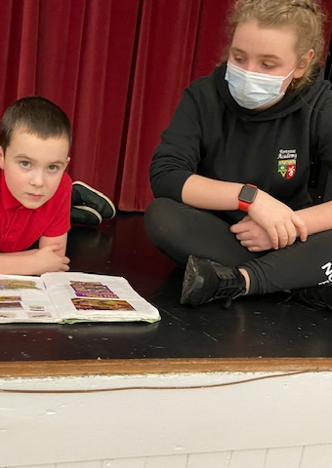
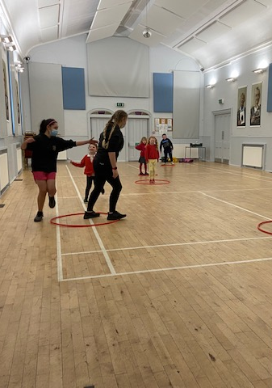

Slide 17
Football Coaching
Football coaching with coaches from Inverness Caley Thistle
Young people were looking at creating their own football team, they were asked to create their own Logo, thinking about colours for the strip and who would be on the team.
Young people are gaining new skills each week. I know this as I am seeing an improvement and the coaches have told me.

Slide 18
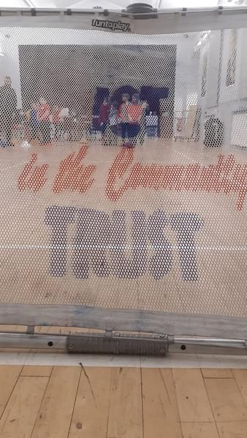

Slide 19
Ethan Paterson Baking / Cooking Bonanza
Every week Ethan volunteers his time to support with the cooking and baking for all activities that the youth café provide.
Ethan research's recipes and then creates the shopping list of what he needs
On Valentines day Ethan made 80 Raspberry and White Chocolate Muffins and Love Heart Shaped Shortbread to bring a bit of cheer!
Ethan is an asset to our Youth Work Team
Our young people are the best fed young people on The Black Isle, with various different types of food being offered and all dietary requirements are catered for. Food is offered at all of our activites.

Slide 20
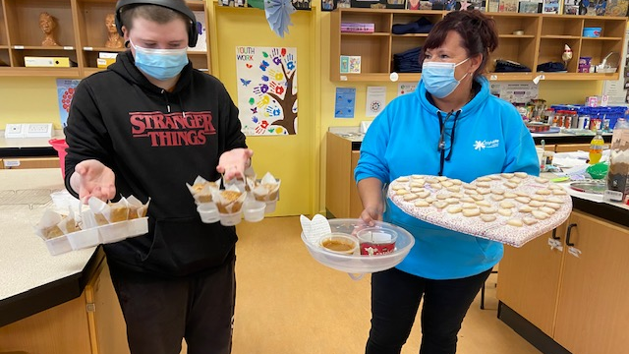

Slide 21
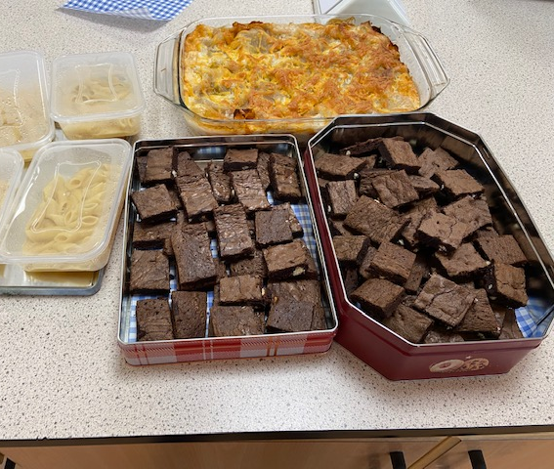
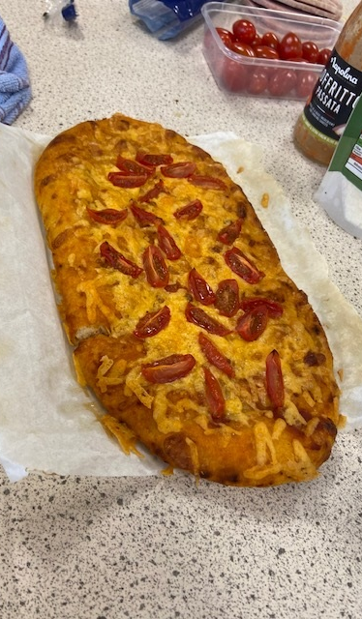
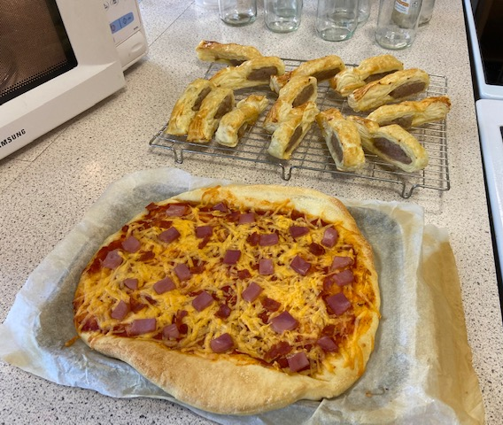
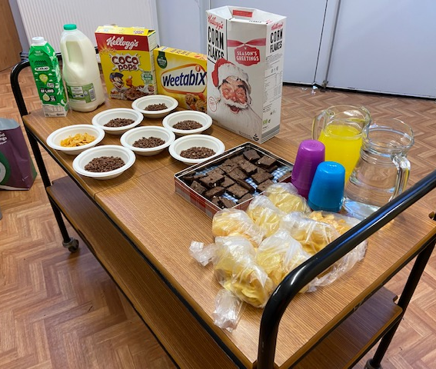
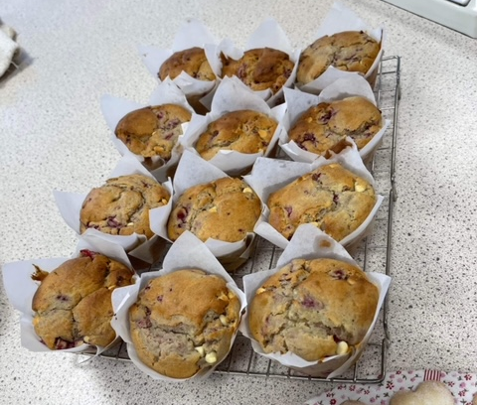

Slide 22
Funding Opportunity
Wanda approached the Youth Café about a pot of funding from Highland council where young people can apply for a grant, and other young people are involved in the decision making as to weather the grant is approved or not.
Young people who are applying for the funding have come up with a wish list:
A Day at paintball
Football Coaching
An intergenerational project
Young people thought it would be good to cover all age ranges.

Slide 23
1-1s
Lots of 1-1s this month,
Supporting young people with UNI / College Applications
Supporting to write Personal Statements
Updating Leadership & Saltire Paperwork
Emotional Check-ins
Baking sessions
Cooking Session
Wanda has been supporting a young person with his biology practical lessons
Planning session for Cromarty Youth Café
Supporting with Driving Theory Test

Slide 24
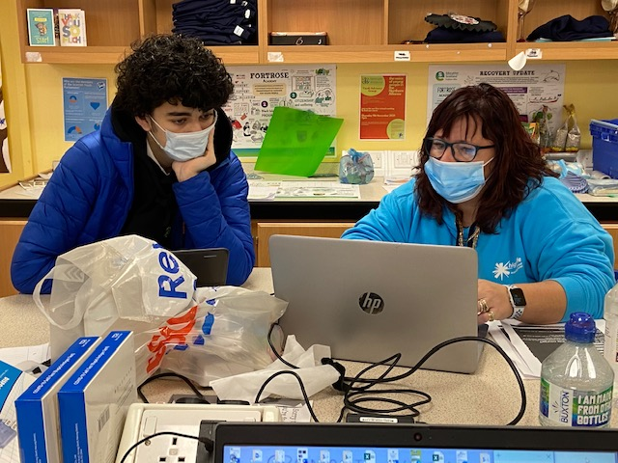

Slide 25
Young Scot Awards
Wanda has nominated 3 young people for Young Scot Awards
These young people have continue to supporting and giving an outstanding contribution to Youth Work and the wider community.
The awards ceremony is down in Edinburgh in April
John Munro has been invited to attend the celebration as he was our finalist last year, as we nominated him

Slide 26
Participation Forums
Over the last month Young people Contunited to participate at these forum below
Cromarty & District Community Council x 2 Youth Reps attending pre meeting to discuss items to be brought up at the main meeting
Cromarty Community Rowing Club x 2 snr youth reps & x3 jnrs reps who are being trained up for when the snrs move on.
Highland Youth Parliament x2 Youth Reps
Northern Alliance x 1 Youth Rep
Equalities and Diversity group

Slide 27
Wider Achievement
Young people taking part in Online Courses on through the CALA Website
Young people are continuing to work on Saltire and HLH Leadership programme, and Tracking and monitoring taking place weekly
Young people taking part in Online Courses through the Virtual College.

Slide 28
Indoor Rowing
Weekly Indoor rowing sessions
Working in improving timings and techniques
Taking part in time trials – 250m, 500m and 1K
All the young people’s times are improving weekly.

Slide 29
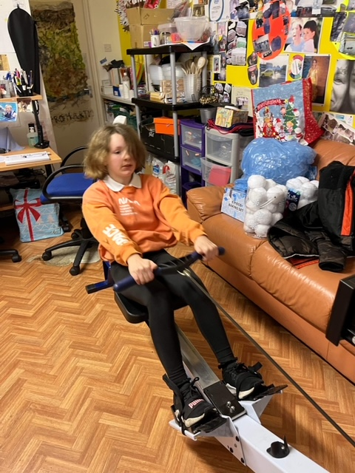
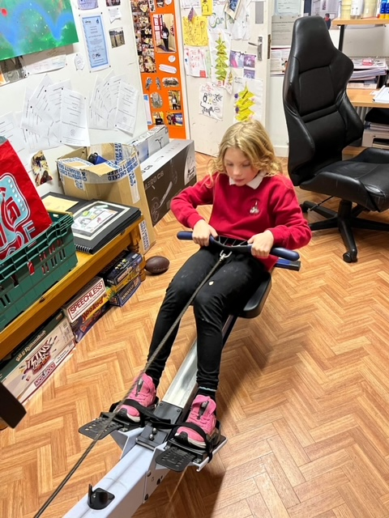
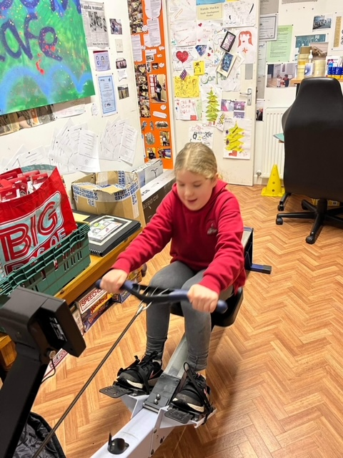
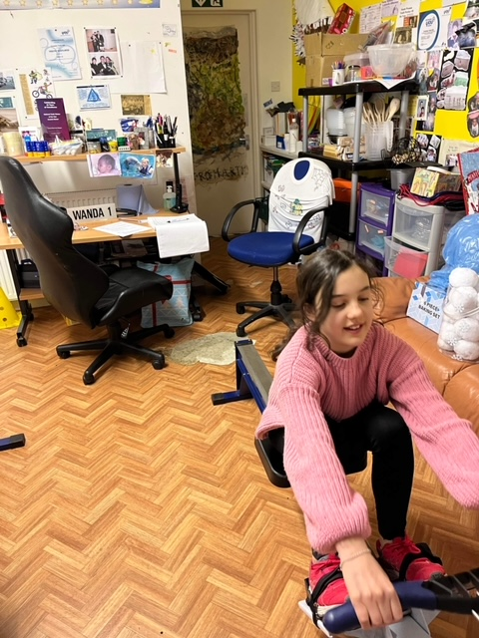

Slide 30
Thank you for taking the time to read this report.
To keep up to date with what we are doing please visit our Facebook Page:
Cromarty Youth Cafe - Home | Facebook

